Slide 1
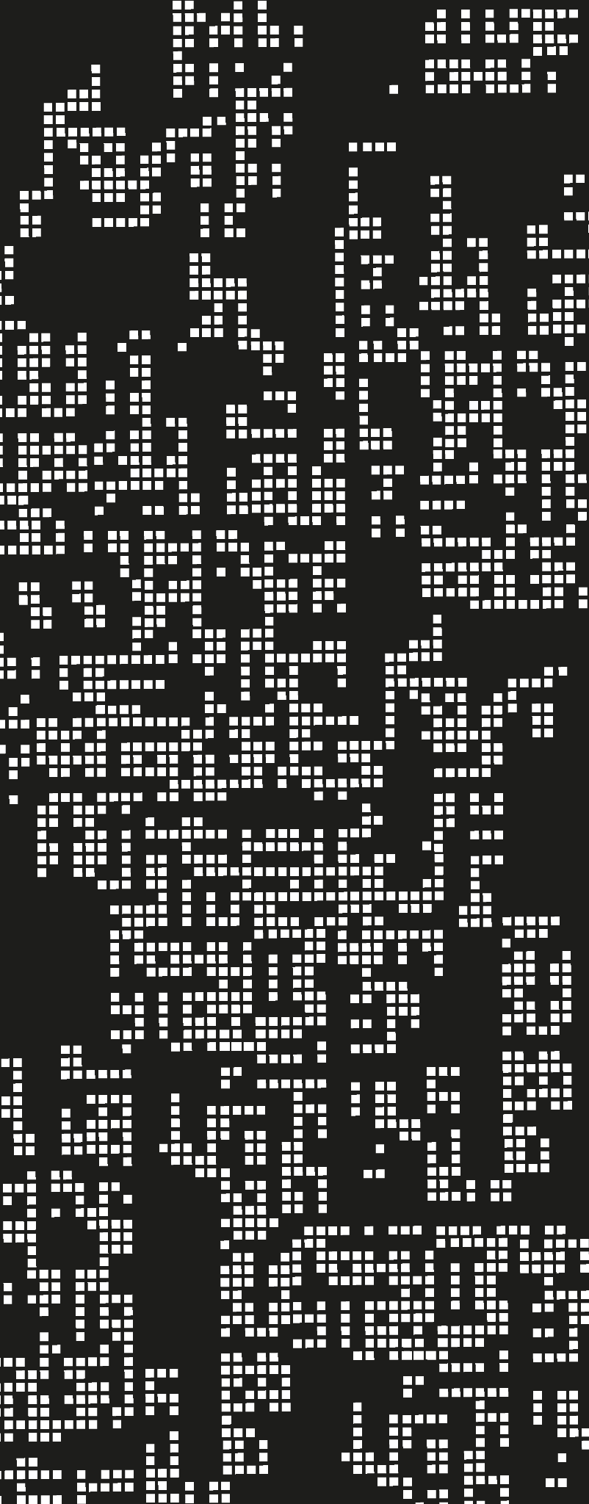
Spam Email Detection
CSCI218 Foundations of AI Group Project
Youtube Link: ()
Github Link: (Github Link)

Slide 2
Group 23:
 | UOW Student No. | Contribution | Task Completed
Rohit Panda | 8943060 | 100% | Training of Traditional Models (Colab) Video recording,editing and uploading Presenter
Russel Hendro Yudo | 8496663 | 100% | Training of BERT (Colab - Incomplete) Presentation Slides (methods) Presenter
Yeonjeong Lee | 8876368 | 100% | Flask App, Frontend and Backend Presenter
Karissa Angeline Ramos Wong | 8877889 | 100% | Presentation Slides Presenter
Naga Maheeth Sreekantom | 7770200 | 100% | Presentation Slides Presenter
Tan Jun Rong, Dillon | 9093187 | 100% | Presentation Slides Literature Review Presenter

Slide 3




Introduction to Spam Email Detection
What is a Spam email?
Why Detect Spam Email?
unsolicited, bulk messages sent to multiple recipients, often for the purposes of advertising, fraud, or phishing.
Prevents Cyber Attacks
Saves Time and Resources
Protects System from Malware

Slide 4

Project background: Spam Email Detection
Goal of this Project!
Create a real-time solutions that can analyses if an email is a scam or not
The solution will be a web application that allows user to paste the email they are suspicious of
How this Project would benefit Society ?
01
02
03
Protects all users from email-based scams
Reduce time spent in identifying and handling spam email
Helps in combating evolving cyber threats

Slide 5
Literature Review
Dataset Shift Problem
Techniques to tackle problem
Causes degradation up to 48.81%
Adversarial Nature of Spammers
Constant adaptation to bypass filters
Adaptive Learning Models
Adversarial Training
Ensemble Method
Notes:
For our literature review, using the provided article in moodle
The authors from the article reviews the importance of dynamic environments and the problem of dataset shifts of spam emails that evolve over time.
Dataset shifts can cause a significant degradation in the performance of spam filters with potential error rates of up to 48.81%. This is due to,
Adversarial Nature of Spammers: As they constantly/rapidly adapt their strategies to bypass existing filters.
A notable pointer in the article is the evolution of spam emails being just annoying and unsolicited advertisement emails to
scams, malware or phishing emails that can compromise the security and integrity of users,
Hence, we focus our project; heavy on the detection of scam emails.
The article explores machine learning technique such as
Adaptive learning Models: which are systems that adjusts to new spam patterns over time
Adversarial Training: which speaks of incorporating potential spammer tactics; and
Ensemble Methods; which is the use of several AI models to enhance detection
to counter the dataset shift problem
Due to constraints with the timeline of our project, we focus on Ensemble Methods in attempt to have a more robust prediction;
NEXT SLIDE

Slide 6
Literature review
Naïve Bayes
SVM
Probabilistic Classifier,
Effective & Efficient
Computationally expensive on large text datasets
Random Forest
KNN
Multiple Decision Trees
Reduces Overfitting.
Inefficient for high-dimensional sparse data
LSTM
Deep Learning
Captures sequence in data,
Understands context.
(DNN/CNN) Requires extensive labeled data & high computation
Notes:
We decided to use Naive Bayes, Random Forest and LSTM ensembled together to train our model.
Why These Models?
Naïve Bayes: Historically effective for spam detection
Random Forest: Robust and reduces overfitting
LSTM: Extends the other 2 models by learning word order with context rather than just treating text as independent words.
Why Not Other Models?
Likely to work well but not chosen due to their high memory and computational needs.
Next, i will pass the time to my groupmate Russel

Slide 7
Methodology - Models
Scope:
Focus on spam email detection using Machine Learning(ML) & Deep Learning (DL).
Evaluating Naïve Bayes, LSTM, Random Forest, BERT for real-time classification.
Prior Work & Justification:
Naïve Bayes: Common baseline, 97.8% accuracy in spam detection (ResearchGate, 2023).
LSTM: Used in spam filtering because it understands word sequences well (IEEE, 2022).
Random Forest: Effective for spam detection using metadata and behavioral features (Springer, 2022)
BERT: Outperforms traditional ML in phishing detection (JCBI, 2023).
Why These Models?
Naïve Bayes: Fast & interpretable, good baseline for comparison.
LSTM: Excels at learning text sequences, useful for detecting sophisticated spam.
Random Forest: It is mainly a predictor model which is useful in making predictions
BERT: Deep language understanding; detects context-based and evasive spam but is computationally expensive
Notes:
Machine Learning (ML):
Learn from example
Deep Learning (DL):
Learn by teaching itself
Prior work & Justification speak for themselves.
Naïve Bayes → A fast, simple guesser that sorts text based on past data, but doesn’t understand word relationships well (e.g., treats “New York” as two separate words)
LSTM → It’s like a smart organizer that sorts documents into topics, even if they don’t use the exact same words!
Random Forest → It’s like a jury where many people vote, so one bad opinion doesn’t affect the final decision too much.
BERT → It’s like a language expert that really understands what words mean, not just their individual parts
Speaker Notes
"Our study focuses on ML and DL techniques for spam detection, building on past research. We chose Naïve Bayes, LSTM, and BERT because they represent three key approaches: Naïve Bayes, a fast and interpretable baseline, has achieved 97.8% accuracy (ResearchGate, 2023). LSTM, a sequential model, is widely used in spam filtering because it captures dependencies in email text (IEEE, 2022). BERT, a deep NLP model, has been shown to outperform traditional ML models in phishing detection (JCBI, 2023).
Other models like Random Forest and SVM rely on handcrafted features, making them less effective for complex text analysis. We also considered GPT-based models, but they are too computationally expensive for real-time spam filtering. By testing these three models, we ensure a balanced comparison between efficiency, accuracy, and real-time feasibility."
Introduce design of implementation and structure of code
Highlight any changes/improvements if use code from third party
Talk about the different models we have chosen for this spam classifier?

Slide 8
Methodology - Implementation
1. Method:
Approach Overview:
We used three different models— Naïve Bayes, LTVSM, Random Forest—for text classification. Each model has different strengths, so we compared them based on efficiency, accuracy, and suitability for spam detection
2.Design and Implementation:
Preprocessing:
Tokenization, Stopword Removal, Vectorization, Splitting Data
Classification Model used:
Naïve Bayes, LTVSM, Random Forest, and BERT
3.Implementation Details:
•Architecture - Google Colab
•Code Structure - Wrote codes in sections
4.Innovations:
Compared 3 models to analyze trade-offs in speed vs accuracy
Visualisation of spam vs ham
Visualisation of common spam word
Confusion Matrix
Classification Report
Notes:
Approach Overview
We used three different models—Naïve Bayes, LTVSM, Random Forest—for text classification. Each model has different strengths, so we compared them based on efficiency, accuracy, and suitability for spam detection.
BERT couldn't be implemented as there was not enough resources to run it
Tokenization - Breaking down the text (email) into smaller units like words or phrases (tokens).
Stopword Removal - Removing common, less meaningful words like “the,” “is,” and “in.”
Vectorization - Converting words into numerical data that a machine learning model can process.
Splitting Data - Dividing the data into training (to teach the model) and testing (to evaluate the model) sets.
Confusion Matrix - Shows how well a model's predictions match the actual results
Classification Report - Shows the accuracy rate and speed rate
Sections where we
Introduce design of implementation and structure of code
Naive Bayes (Probabilistic Model) :
Definition - Checks how likely something belongs to a category based on past data
Pro - Fast & Efficient for large data set, requires less training data and works well for text classification problems e.g spam filtering, sentiment analysis
Con - Assume each word in sentence is independent when in reality, words often depend on each other for example New York should be one but it just separates it as New and York, It doesn't understand word meaning well for example it may treat “not bad” and “bad” as the same when “not bad” means “good”
TLDR: A fast, simple guesser that sorts text based on past data, but doesn’t understand word relationships well (e.g., treats “New York” as two separate words)
LTVSM (Topic-Based Model):
Definition - Group words and documents by meaning to help find hidden topics in text
Pro - Better understanding of words (Knows that happy and joyful are related), Good for grouping similar documents (e.g. help organise emails, articles or reviews into topics)
Con - Takes more time to process, harder to understand as not always clear why it groups words a certain way
TLDR: It’s like a smart organizer that sorts documents into topics, even if they don’t use the exact same words!
Random Tree Model (Decision-Based Model):
Definition - Think of it like a group of decision-makers (trees) voting. Each tree make its own decision and the majority wins\
Pro - More accurate than a single decision tree as multiple decisions are combined, Handle messy data like missing values or outliers well, works for both num and text (e.g., predicting prices or classifying spam)
Con - Slower than other models, Hard to understand why it makes a decision(more like “black box”)
TLDR: It’s like a jury where many people vote, so one bad opinion doesn’t affect the final decision too much. BERT (Deep Learning Model)
Definition - A super smart model that understands the meaning of words based on context (e.g., it knows "bank" in "river bank" is different from "bank account"
Pro - Understand word relationships better than other models, Great for complex language tasks like chatbots and search engines
Con - Very slow and need a lot of RAM, Takes a lot of data and time to train properly
TLDR:
It’s like a language expert that really understands what words mean, not just their individual parts
Highlight any changes/improvements if use code from third party
Talk about the different models we have chosen for this spam classifier?

Slide 9

Methodology - Application
Accessibility & Ease of Use
Real-time Detection & Deployment
Lightweight & Efficient
Model Integration and Compatibility Issues
Web Application Design and User Experience
Model Evolution and Improving Accuracy
Why we use Flask app?
2. Challenging Point
Notes:
This time, I’d like to introduce a web application I developed for spam email detection. To build this, I used Flask, which is a Python-based web framework.
So, why did I choose Flask?
First, Accessibility & Ease of Use.
Flask makes it really simple for users to check if an email is spam from any device with a web browser.
They don’t need to install anything or worry about dependencies.
Plus, I designed the interface to be intuitive so that even non-technical users can easily use it.
Next, Real-time Detection & Deployment.
The model can analyze an email and provide results instantly.
Flask also allows seamless integration with email services, which could be used for real-time spam filtering.
But in this project, I kept it simple. users can just copy and paste an email into the app to check if it’s spam. And once deployed, multiple users can access it without installing anything.
Finally, Lightweight & Efficient.
Flask is a lightweight framework, which means it’s a great choice for deploying machine learning models without using too many resources.
Compared to heavier frameworks, it helps reduce operational costs.
Also, the API responds quickly, ensuring a smooth user experience.
Of course, there were some Challenges I Faced While Developing This Web Application
First, Model Integration and Compatibility Issues.
This application actually uses three different models and each one requires a different preprocessing method.
For example, LSTM models use tokenizers and padding, while the other two use TF-IDF vectorization.
Making sure everything worked together smoothly was quite tricky!
Next, Web Application Design and User Experience.
I wanted to make sure the interface was user-friendly and easy to understand.
One challenge was making sure the results updated dynamically without needing to reload the entire page.
Also, I had to think carefully about how to display probability so that users wouldn’t misinterpret the results.
For example, I used a method where the spam emoji is displayed larger as the spam probability increases.
And finally, Model Evaluation and Improving Accuracy.
One of the biggest challenges was balancing false positives and false negatives.
If the model is too aggressive, it could flag normal emails as spam, and if it’s too lenient(리니언트), it might let actual spam emails slip through.
So, I had to fine-tune the spam probability threshold(뜨레숄드), which I set at 60%.
Since I used three different models, I also had to decide how to combine their results. I considered a few options:
1. Going with the prediction that at least two models agreed on.
or Taking the simple average of all three models’ probabilities.
and also considered Assigning different weights to each model before averaging.
In the end, I decided to go with the simple averaging method to determine the final prediction.

Slide 10
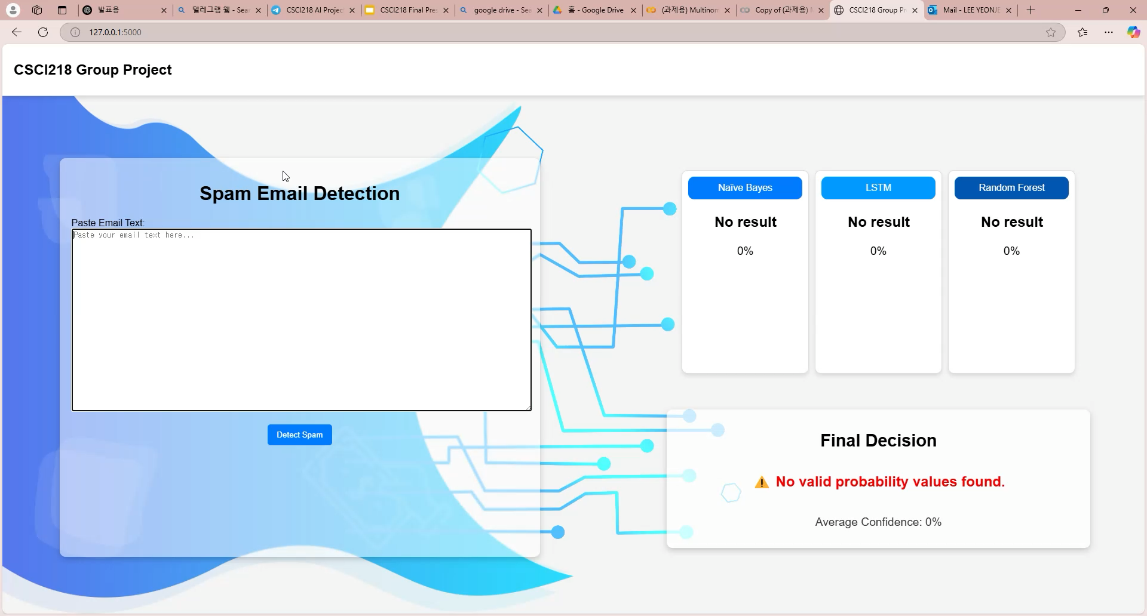
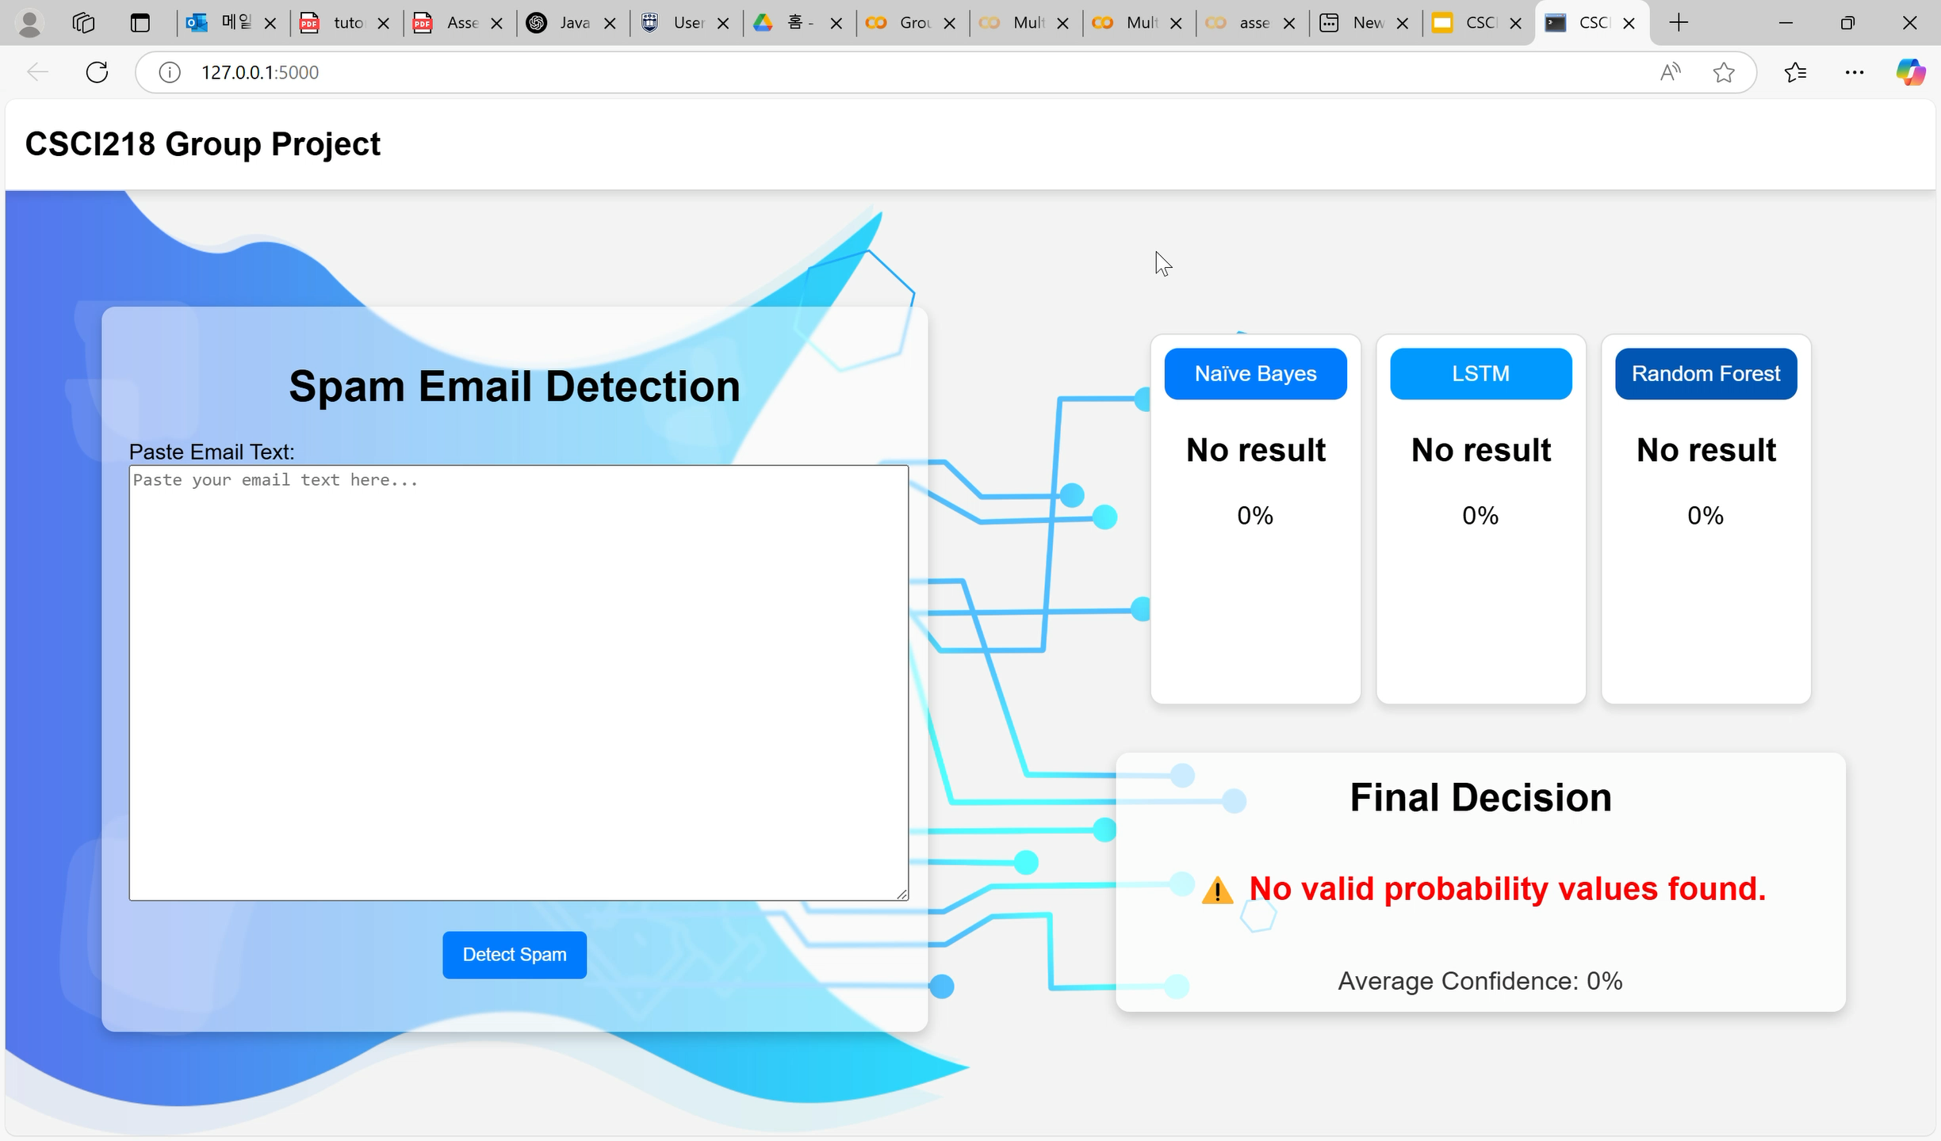
Running App
(Spam)
Running App
(Not Spam)

Slide 11
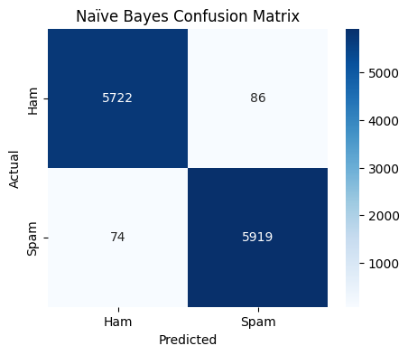
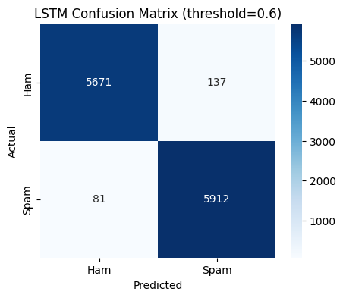
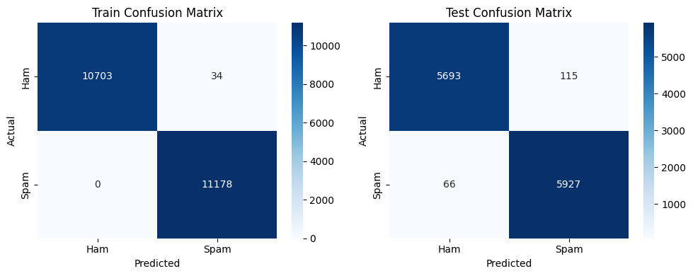
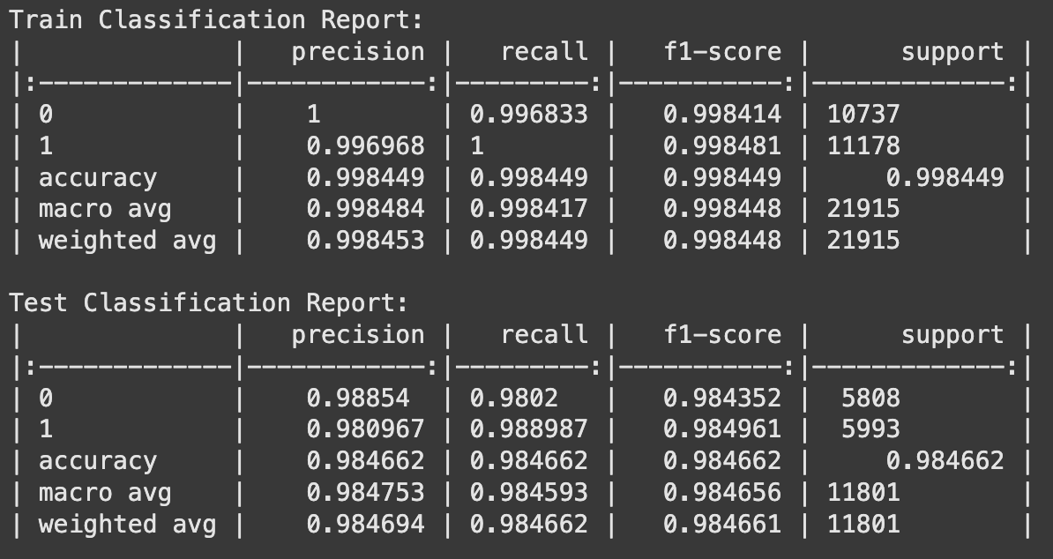
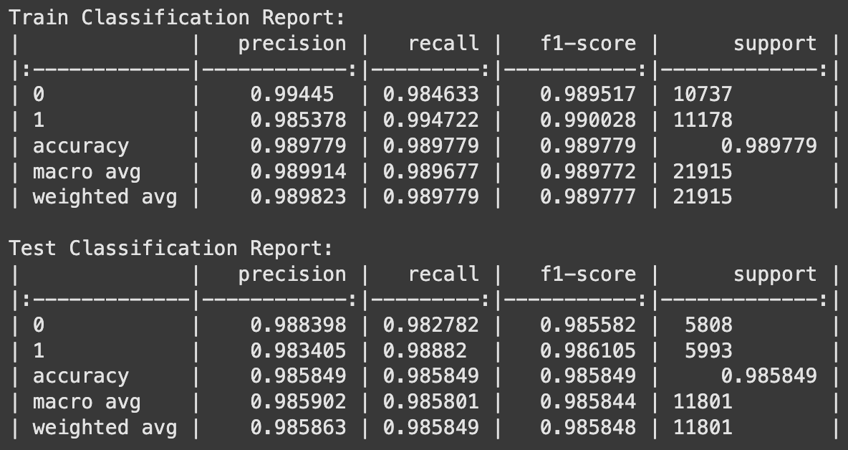
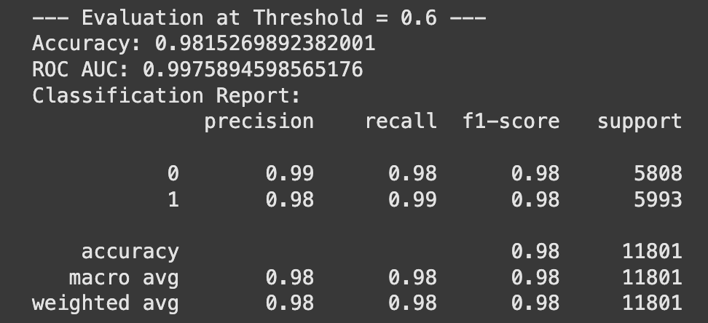
Results
Random Forest

Slide 12
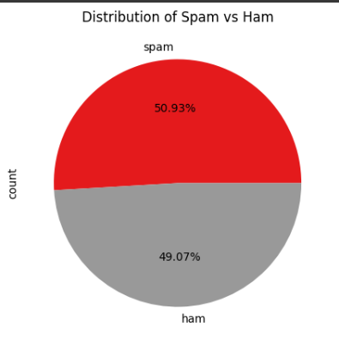
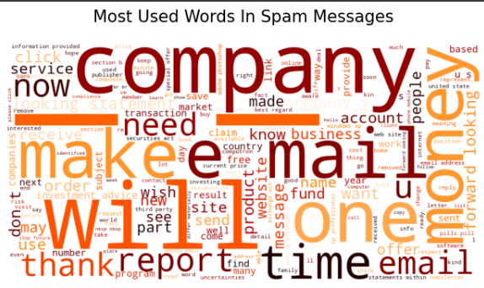
Results

Slide 13
Conclusion
Summary:
BERT is the best choice if can afford computational power
Random Forest-best choice if cannot afford computational power
Future Direction:
Incorporating metadata and behavioral features can improve accuracy significantly
Hybrid Model Approach
Implement incremental learning
Use User feedback
App Integration
Provide explanation for why it was flagged
Notes:
Naga
So in summary, the BERT model is an excellent choice if there is an abundance of computational power and random forest if there is limited computational power at hand.
We could utilize the Hybrid Model Approach which combines different machine learning models to improve accuracy and reduce false positives. An example is combining the Naïve Bayes model, which quickly filters spam based on word probabilities, with the Random Forest model, which analyzes sender info, email headers, and attachments to detect more advanced spam
We also ensure there is Incremental Learning for models so that the model is dynamic and the dataset is not static as there are new spam emails everyday
We should also integrate User Feedback as it Helps fine tune the models baseline
App Integration should also be possible to increase usability and make real world impact.
We should also provide a reason for why a particular email was flagged as a spam as it builds trust and transparency with the user as in cybersecurity as the biggest weakness in cybersecurity is humans.
NEXT SLIDE
In the future,
We should incorporate metadata like the technical details of the email like the domain which is not in the body of the email itself and behavioural features which is how user interacts with the email over time so that accuracy is improved significantly.

Slide 14
Q&A!

